Slide 1
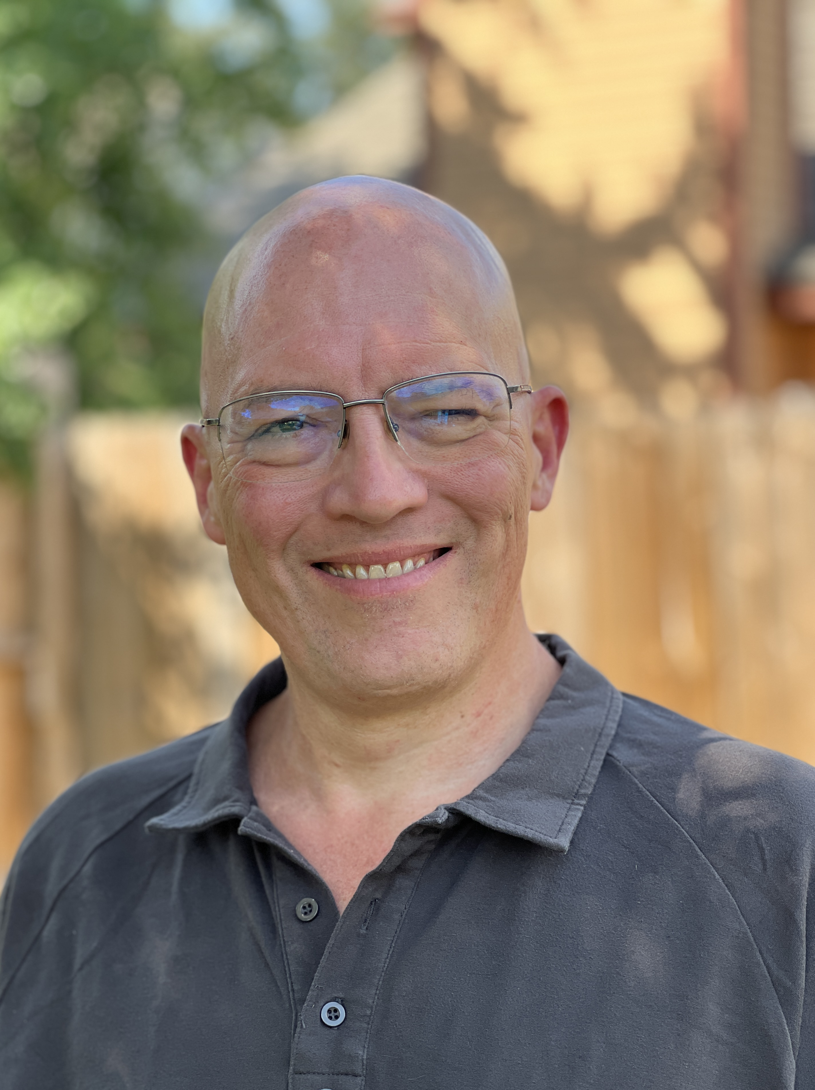
Mark “Mister Productivity” Struczewski
Helping entrepreneurs and leaders reclaim
10+ hours a week without hustle or burnout
using the proven CUT framework.
Host of The Mister Productivity Podcast
1,350+ episodes since 2017
(713) 702-6052 | ski@misterproductivity.com
MisterProductivity.com

