Slide 1
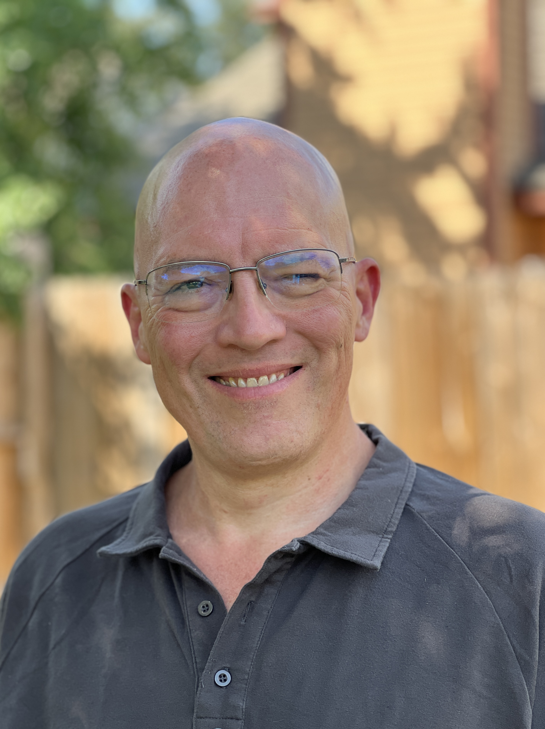
Mister Productivity
(Mark Struczewski)
Double Your Output. Halve the Hustle.
Reclaim 10+ hours/week with the CUT framework.
Host of The Mister Productivity Podcast
1,360+ Episodes since 2017
(Daily Runner since 2017)
(713) 702-6052 | ski@misterproductivity.com
@misterproductivity
MisterProductivity.com

